Slide 1
Presentation on Tech School (An E-Learning Website)
Submitted By | Submitted To
Prosenjit Kumar Pal ID: 172-35-2201 Batch: 23 Department of Software Engineering Daffodil International University | Mr. A.H.M Shahariar Parvez Associate Professor Department of Software Engineering Daffodil International University

Slide 2
Table of Contents
Introduction
Objectives and Goals
Requirements
Use Case Diagram
Case Description
Activity Diagram
Sequence Diagram
Class Diagram
ER Diagram
Tools and Technologies
Project Schedule
References

Slide 3
Introduction
Introducing an innovative E-Learning Management System designed to reshape online education for a global community of learners, instructors, and administrators.
Stakeholders
Learner
Instructor
Admin

Slide 4
Objectives and Goals
Learners can register through online
They can register course through online
They can give feedback
They can pay through online payment system

Slide 5
Functional Requirements
FR-01 | Registration
Description | Users must have the ability to register for the system by providing their name, email, and password.
Stakeholders | All users (Learners, Instructors, admins)
Priority | High
FR-02 | Login
Description | Registered users should be able to log in securely using their username and password.
Stakeholders | All users (Learners, Instructors, admins)
Priority | High

Slide 6
Functional Requirements
FR-03 | Course Management
Description | Only an admin able to create new courses by providing a course title, description, and other relevant information. And also can edit existing courses, and delete courses from the system.
Stakeholders | Admin
Priority | High
FR-04 | Course Enrollment
Description | Students are able to browse available courses and enroll in them.
Stakeholders | Learners
Priority | High

Slide 7
Functional Requirements
FR-05 | Payment Processing
Description | The system supports payment processing for course fees.
Stakeholders | Learners
Priority | High
FR-06 | Blog Post Creation and Mange
Description | Teachers should have full control over their blog posts, including the ability to create new blogs, edit the content and title of their existing blogs, and delete any of their posted blogs.
Stakeholders | Instructors
Priority | High

Slide 8
Functional Requirements
FR-07 | Blog Post Reading
Description | All users should be able to read blog posts created by teachers.
Stakeholders | All users (students, teachers, admins)
Priority | High
FR-08 | Provide Course Feedback
Description | Students should have the capability to provide feedback on courses in which they are enrolled.
Stakeholders | Learners
Priority | Medium

Slide 9
Functional Requirements
FR-09 | Course Feedback Viewing
Description | All users should be able to view and access feedback provided by learners for a particular course.
Stakeholders | All users (Learners, Instructors, admins)
Priority | Medium
FR-10 | Course Material Management
Description | Instructor should have the capability to add course materials to their courses. Additionally, teachers should be able to edit and delete the course materials they have created.
Stakeholders | Instructors
Priority | High

Slide 10
Functional Requirements
FR-11 | Course Material Viewing
Description | Learners should be able to view the course materials for courses in which they are enrolled.
Stakeholders | Learners
Priority | High
FR-12 | User Role Management
Description | When a new user completes registration for the system, their default role should be set as "Learner." Admins should have the authority to update user roles, changing them from "Learner" to "Instructor" as needed.
Stakeholders | Admin
Priority | Medium

Slide 11
Functional Requirements
FR-13 | User Removal
Description | Admins should have the authority to remove any user from the system as needed. This action permanently deletes the user's account and associated data from the system.
Stakeholders | Admin
Priority | High
FR-14 | User Profile Editing
Description | Users should be able to edit their profiles and update personal information, including email and password.
Stakeholders | All users (Learners, Instructors, admins)
Priority | Medium

Slide 12
Functional Requirements
FR-15 | User Logout
Description | Users, including students, teachers, and admins, should have the ability to log out securely from the system.
Stakeholders | All users (Learners, Instructors, admins)
Priority | Medium

Slide 13
Non-functional Requirements
NFR-01 | Performance
Description | The system should provide a responsive and fast user experience, with page load times not exceeding [specified time limit] even with a large number of concurrent users.
Stakeholders | All Users (students, teachers, admins)
Priority | High
NFR-02 | Security
Description | User data, including personal information and payment details, should be securely stored and transmitted using encryption and other appropriate security measures. Authentication and authorization mechanisms should prevent unauthorized access.
Stakeholders | All Users
Priority | High

Slide 14
Non-functional Requirements
NFR-03 | Usability
Description | The user interface should be intuitive and user-friendly, providing a positive user experience. The system should be accessible to users with disabilities, adhering to relevant accessibility standards.
Stakeholders | All Users
Priority | Medium
NFR-04 | Reliability
Description | The system should be available 24/7, with minimal downtime for maintenance. Backup and recovery mechanisms should be in place to prevent data loss and ensure system reliability.
Stakeholders | All Users
Priority | High

Slide 15
Non-functional Requirements
NFR-05 | Documentation
Description | Comprehensive documentation should be available for users, administrators, and developers, providing clear instructions on system usage, configuration, and maintenance.
Stakeholders | All Users
Priority | Medium

Slide 16
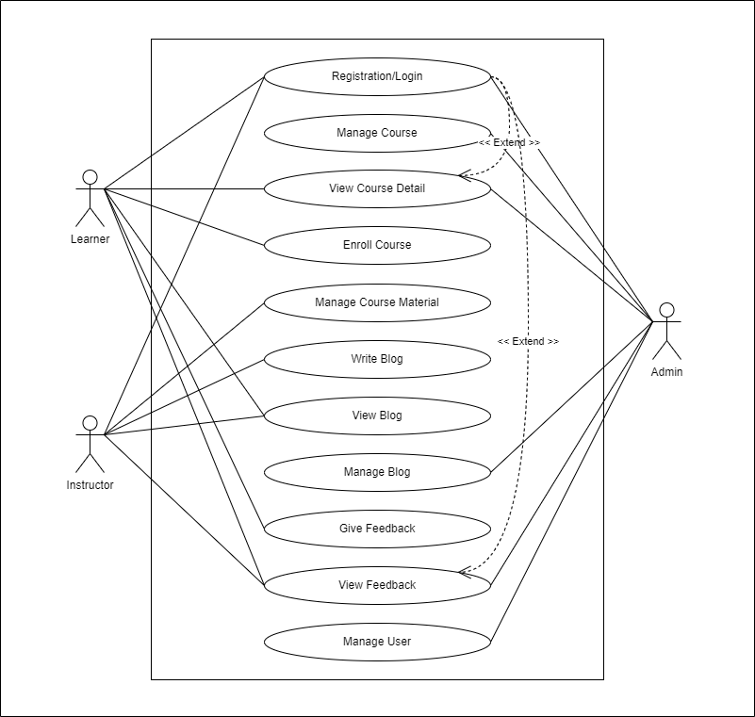
Use Case Diagram

Slide 17
Use Case Description
Use Case ID | UC-01
Use Case Name | Registration/Login
Actor | All users (Learners, Instructors, admins)
Description | Users (learners, instructors, admins) can register for the system and log in to access their accounts.
Precondition | User is not logged in.
Trigger | User accesses the system.
Flow of Events | User selects the "Register" option. User provides registration details (name, email, username, password). User submits the registration form. User receives a confirmation email. User selects the "Login" option. User enters their username and password. User clicks "Login."
Postcondition | User is logged in and can access their account.
Use Case ID | UC-02
Use Case Name | Manage Course
Actor | Admin
Description | Admins can create, edit, and delete courses in the system.
Precondition | Admin is logged in.
Trigger | Admin selects the course management option.
Flow of Events | Admin selects "Create Course" to add a new course. Admin enters course details and Admin clicks "Create." Admin selects an existing course to edit. Admin modifies course details. Admin clicks "Save Changes." Admin selects a course to delete. Admin confirms deletion.
Postcondition | Course management is updated according to admin actions.

Slide 18
Use Case Description
Use Case ID | UC-03
Use Case Name | View Course Detail
Actor | All Users
Description | All users can view details of a course, including its title, description, and instructor.
Precondition | User is logged in.
Trigger | User selects a course to view.
Flow of Events | User navigates to the course details page. User selects a course to view.
Postcondition | User can see the details of the selected course.
Use Case ID | UC-04
Use Case Name | Manage Course Material
Actor | Instructor
Description | Instructors can add, edit, and delete course materials for the courses they teach.
Precondition | Instructor is logged in.
Trigger | Instructor selects the course material management option.
Flow of Events | Instructor selects "Add Material" for a course. Instructor uploads course material and Instructor clicks "Add." Instructor selects an existing material to edit. Instructor modifies material details. Instructor clicks "Save Changes." Instructor selects a material to delete.
Postcondition | Course materials are updated according to instructor actions.

Slide 19
Use Case Description
Use Case ID | UC-05
Use Case Name | Enroll Course with Payment
Actor | Learner
Description | Learners can enroll in courses by making payments for the chosen courses.
Precondition | Learner is logged in.
Trigger | Learner selects a course to enroll in.
Flow of Events | Learner selects a course to enroll in. Learner proceeds to payment. Learner provides payment details and confirms payment.
Postcondition | Learner is enrolled in the selected course upon successful payment.
Use Case ID | UC-06
Use Case Name | Write Blog
Actor | Instructor
Description | Instructors can create and publish blog posts.
Precondition | Instructor is logged in.
Trigger | Instructor selects the "Write Blog" option.
Flow of Events | Instructor enters blog post content (title, content). Instructor clicks "Publish."
Postcondition | The blog post is published and visible to all users.

Slide 20
Use Case Description
Use Case ID | UC-07
Use Case Name | View Blog
Actor | All Users
Description | All users can view blog posts created by instructors.
Precondition | User is logged in.
Trigger | User selects a blog post to view.
Flow of Events | User navigates to the blog post. User selects a blog post to view.
Postcondition | User can see the content of the selected blog post.
Use Case ID | UC-08
Use Case Name | Manage Blog
Actor | Admin
Description | Admins can edit and delete blog posts created by instructors.
Precondition | Admin is logged in.
Trigger | Admin selects the blog management option.
Flow of Events | Admin selects a blog post to edit. Admin modifies the blog post content. Admin clicks "Save Changes." Admin selects a blog post to delete. Admin confirms deletion.
Postcondition | Blog posts are updated or removed according to admin actions.

Slide 21
Use Case Description
Use Case ID | UC-09
Use Case Name | Give Feedback
Actor | Learner
Description | Learners can provide feedback on courses in which they are enrolled.
Precondition | Learner is logged in and enrolled in at least one course.
Trigger | Learner selects a course to provide feedback.
Flow of Events | Learner selects a course to provide feedback. Learner enters feedback comments and ratings (if applicable). Learner submits the feedback.
Postcondition | Learner's feedback is recorded for the selected course.
Use Case ID | UC-10
Use Case Name | View Feedback
Actor | All Users
Description | All users can view feedback provided by learners for specific courses.
Precondition | User is logged in.
Trigger | User selects a course to view feedback.
Flow of Events | User navigates to the course feedback section. User selects a course to view feedback.
Postcondition | User can see feedback comments and ratings for the selected course.

Slide 22
Use Case Description
Use Case ID | UC-11
Use Case Name | Manage User
Actor | Admin
Description | Admins can manage user accounts, including creating, editing, and deleting user profiles.
Precondition | Admin is logged in.
Trigger | Admin selects the user management option.
Flow of Events | Admin selects "Create User" to add a new user. Admin enters user details (name, email, role). Admin clicks "Create." Admin selects an existing user to edit. Admin modifies user details. Admin clicks "Save Changes." Admin selects a user to delete. Admin confirms deletion.
Postcondition | User management is updated according to admin actions.

Slide 23
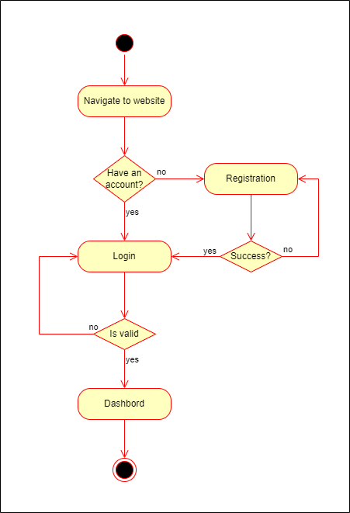
Activity Diagram (Registration/Login)

Slide 24
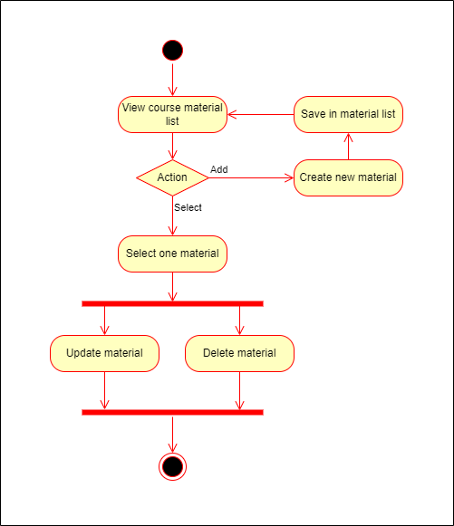
Activity Diagram (Manage Course)

Slide 25
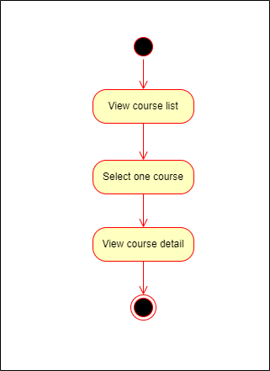
Activity Diagram (View Course Detail)

Slide 26
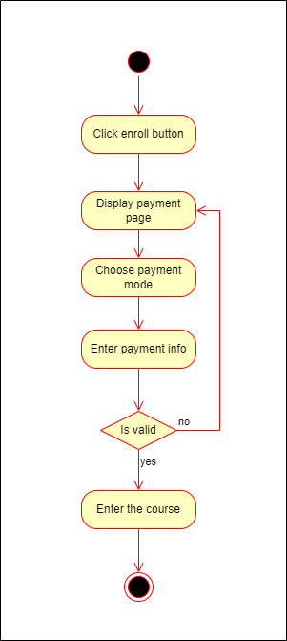
Activity Diagram (Enroll Course)

Slide 27
Activity Diagram (Enroll Course)

Slide 28
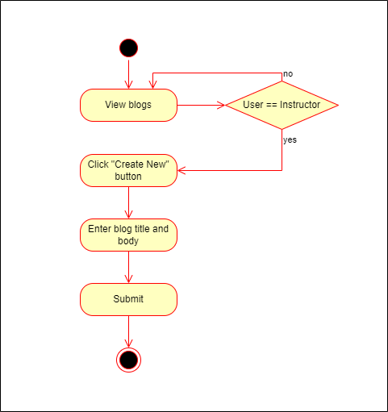
Activity Diagram (Write Blog)

Slide 29
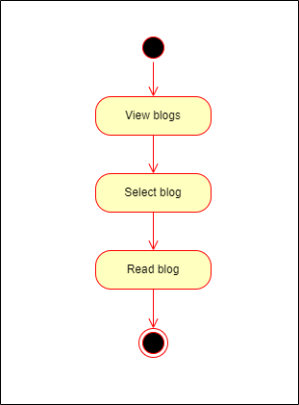
Activity Diagram (View Blog)

Slide 30
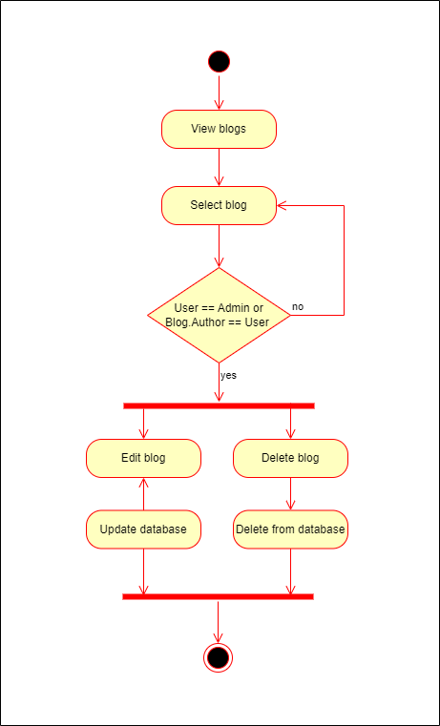
Activity Diagram (Manage Blog)

Slide 31
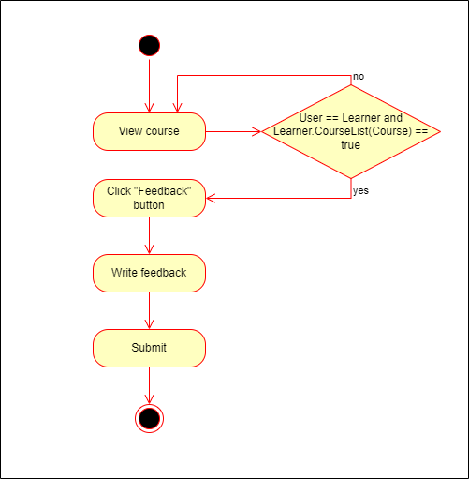
Activity Diagram (Give Feedback)

Slide 32
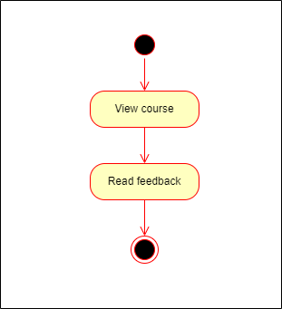
Activity Diagram (View Feedback)

Slide 33
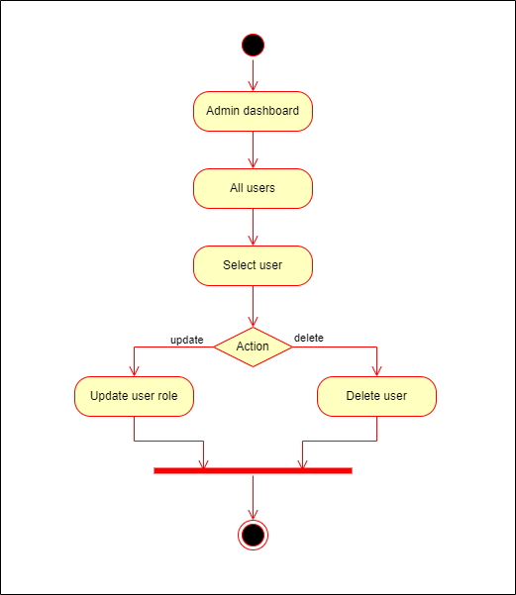
Activity Diagram (Manage Users)

Slide 34
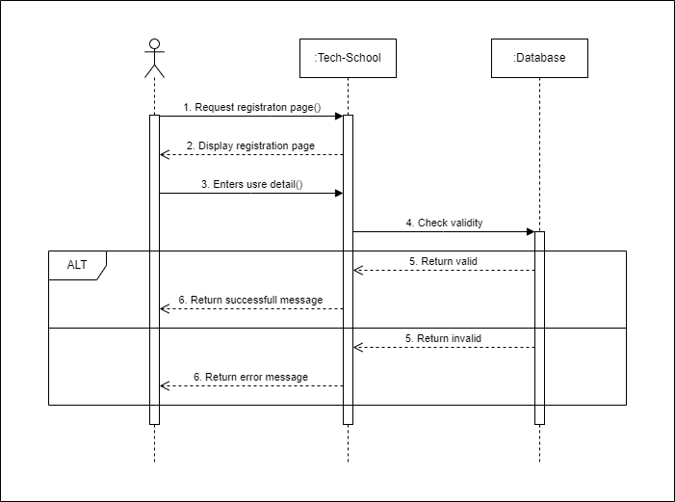
Sequence Diagram (Registration/Login)

Slide 35
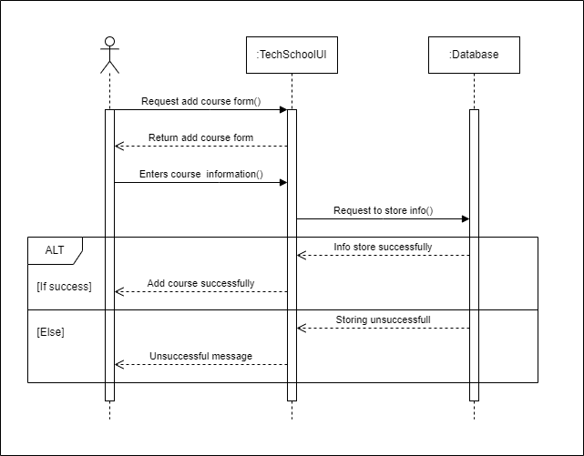
Sequence Diagram (Add Course)

Slide 36
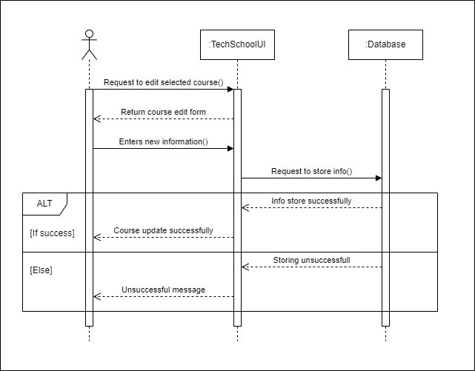
Sequence Diagram (Edit Course)

Slide 37
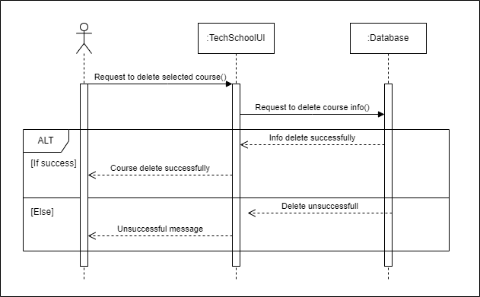
Sequence Diagram (Delete Course)

Slide 38
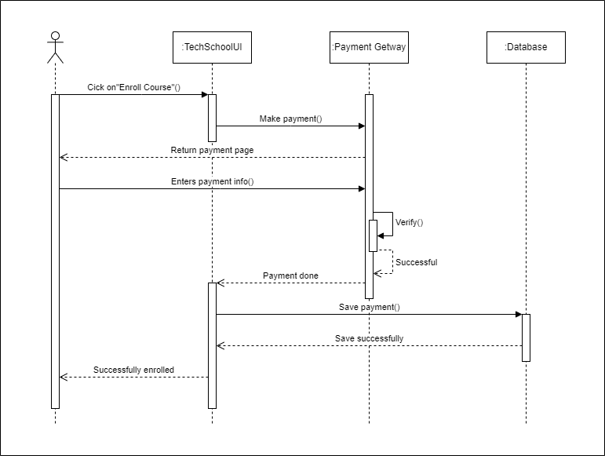
Sequence Diagram (Enroll Course)

Slide 39

Sequence Diagram (Add Course Material)

Slide 40

Sequence Diagram (Edit Course Material)

Slide 41

Sequence Diagram (Delete Course Material)

Slide 42
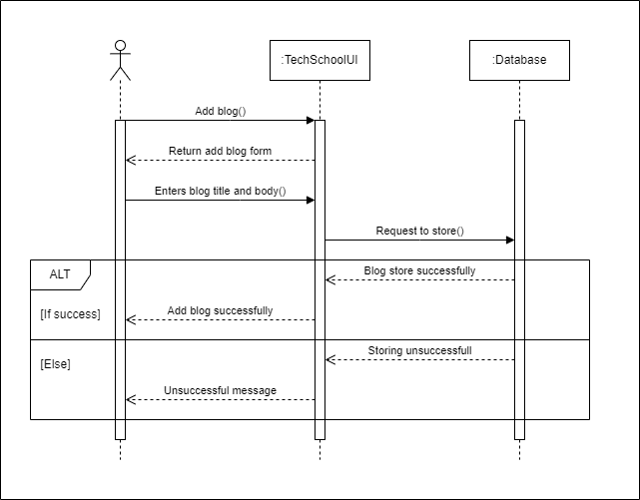
Sequence Diagram (Add Blog)

Slide 43

Sequence Diagram (Edit Blog)

Slide 44
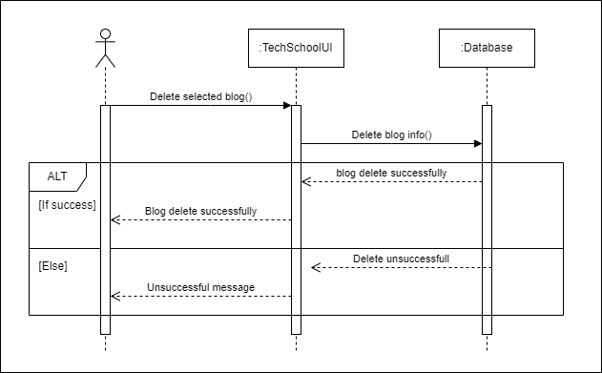
Sequence Diagram (Delete Blog)

Slide 45
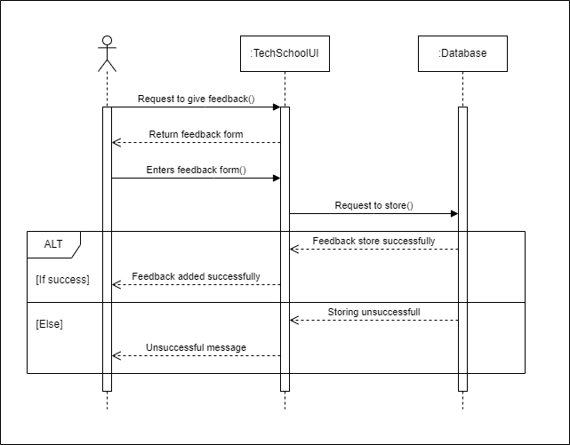
Sequence Diagram (Add Feedback)

Slide 46

Sequence Diagram (User Removal)

Slide 47
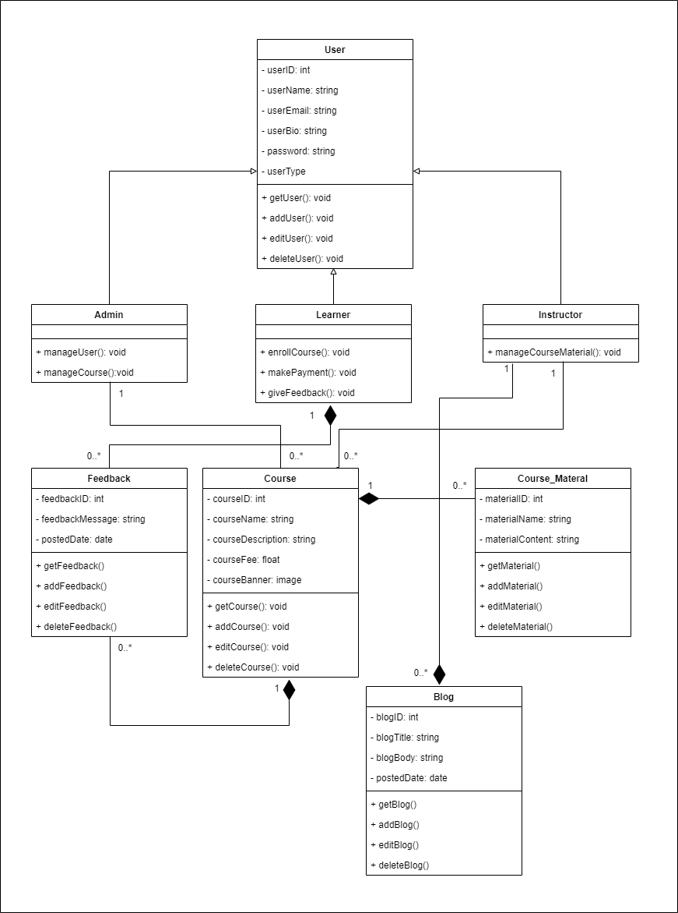
Class Diagram

Slide 48
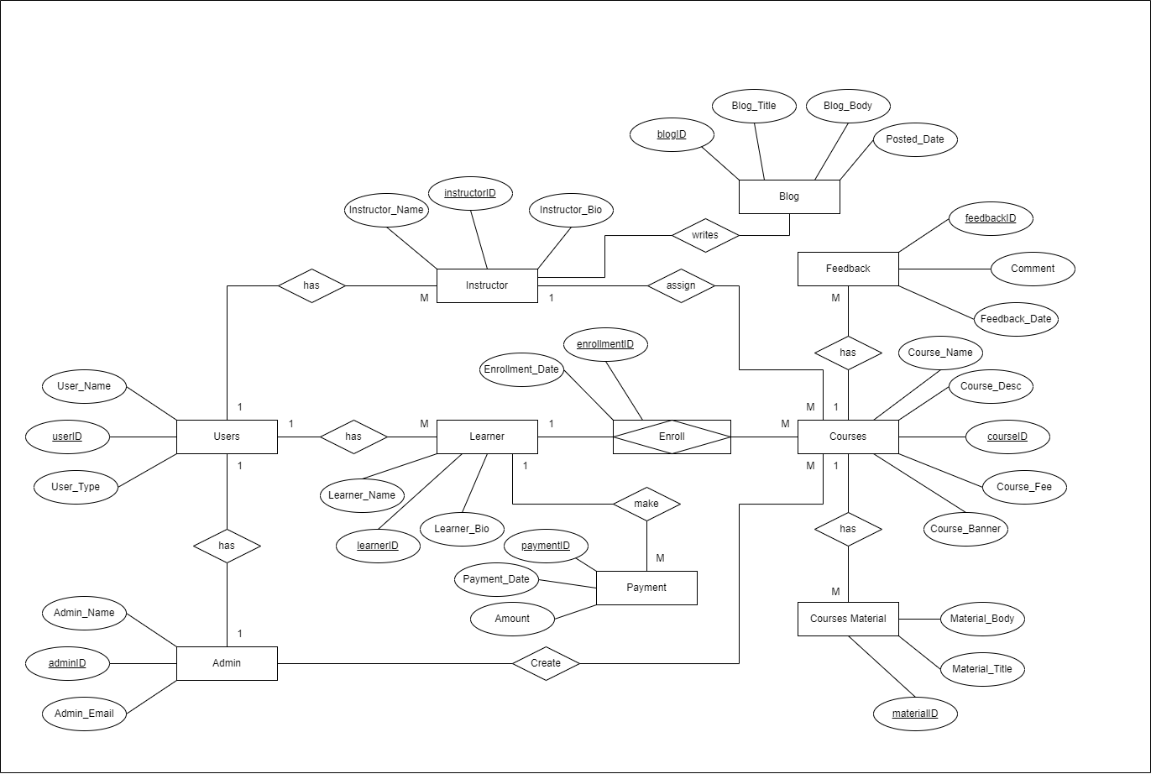
ER Diagram

Slide 49
Tools and Technologies
Programming Language | JavaScript (intermediate)
Database | MongoDB
CSS Framework | Tailwind CSS
Libraries | ReactJS
Server | NodeJS
Tools | VS Code

Slide 50
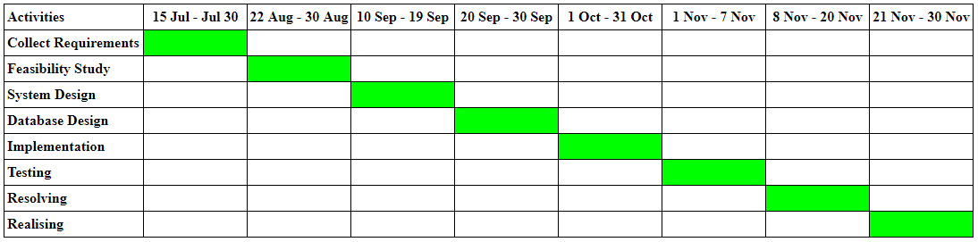
Project Schedule

Slide 51
References UML Diagrams: https://www.uml-diagrams.org/uml-25-diagrams.html ER Diagram: https://creately.com/guides/er-diagrams-tutorial/ Requirements Analysis: https://www.simplilearn.com/what-is-requirement-analysis

Slide 52
Thank You

